Slide 1
Cartography with QGIS and R
Feb 21st 2024

Slide 2
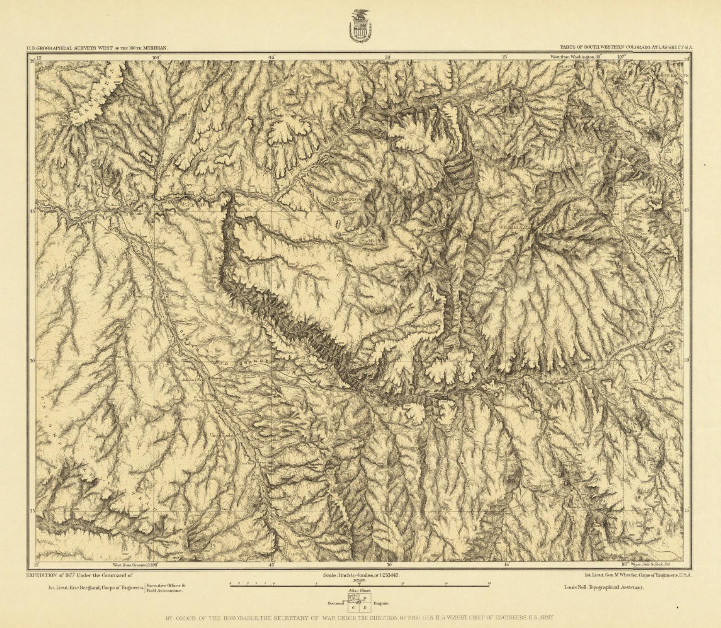
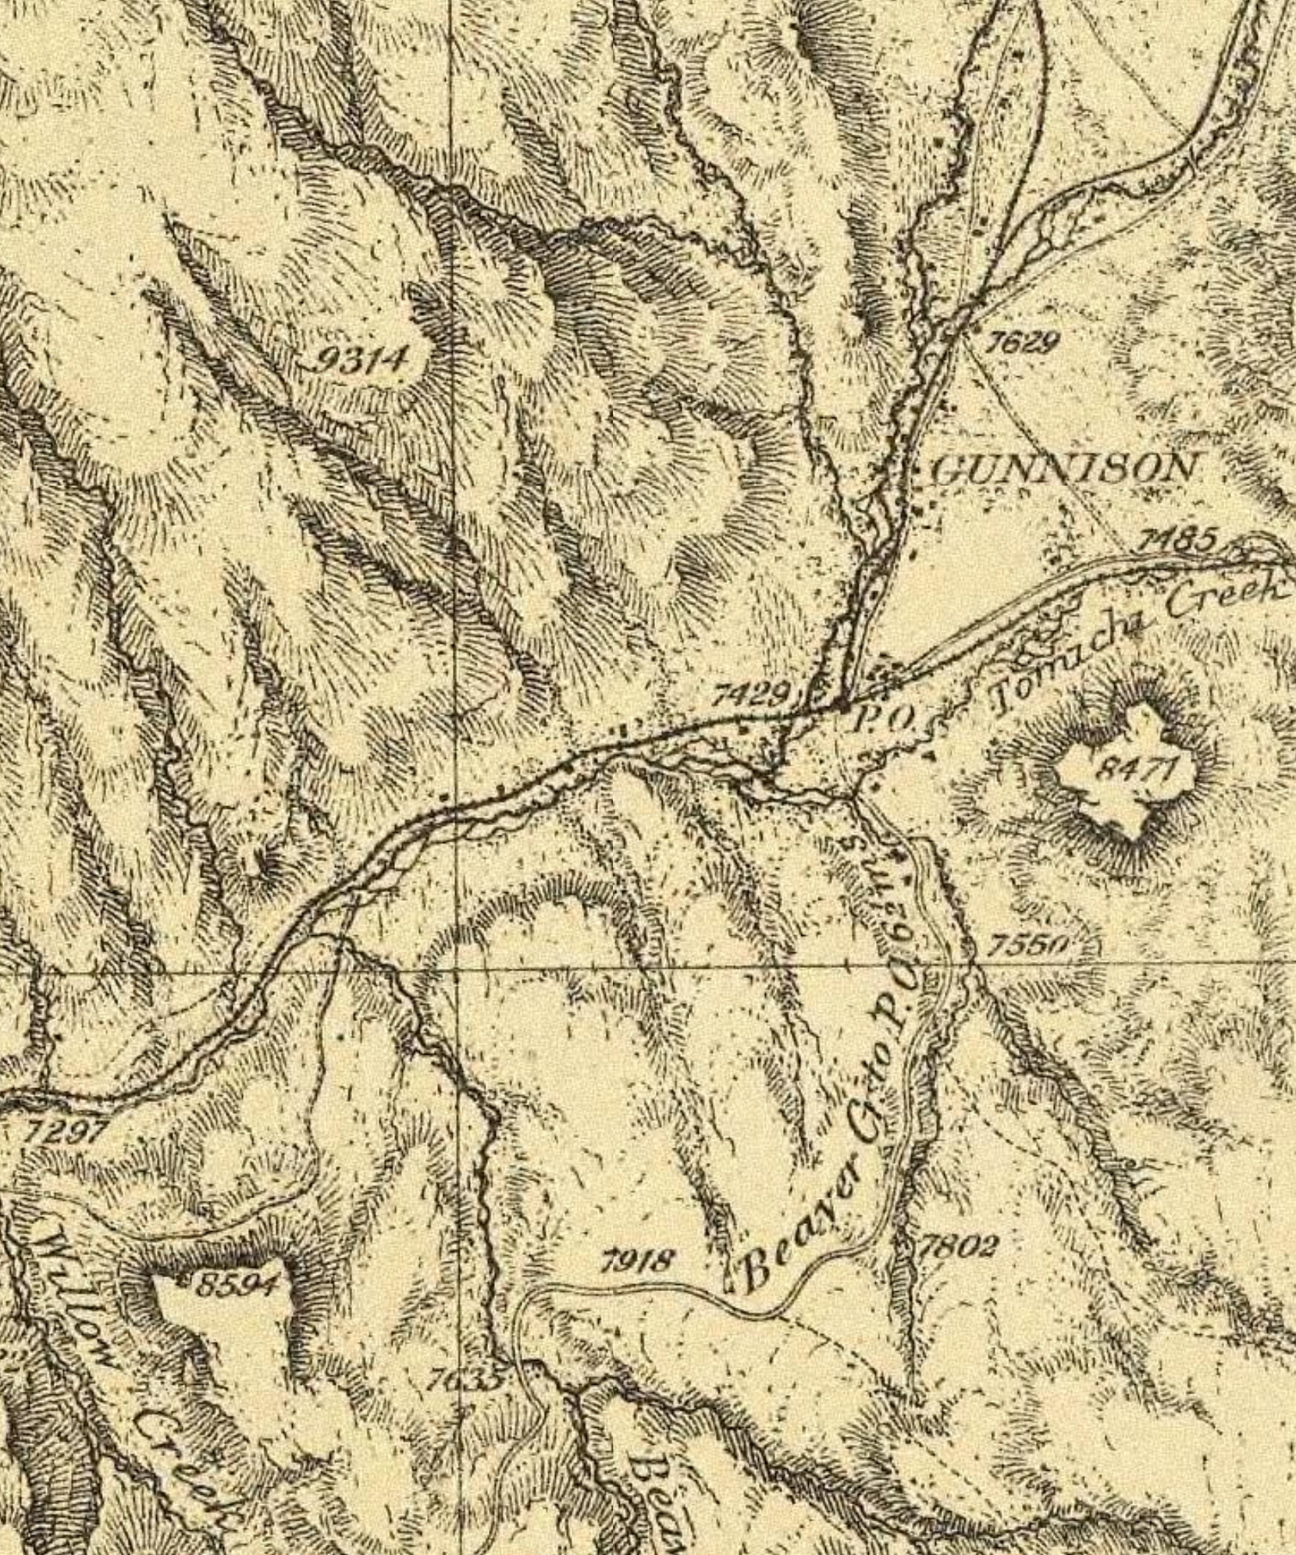
Cartography is Old
“language” changes
Black Canyon of the Gunnison, 1877

Slide 3
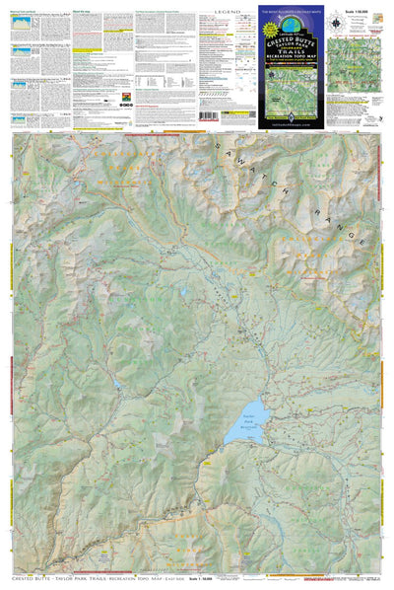
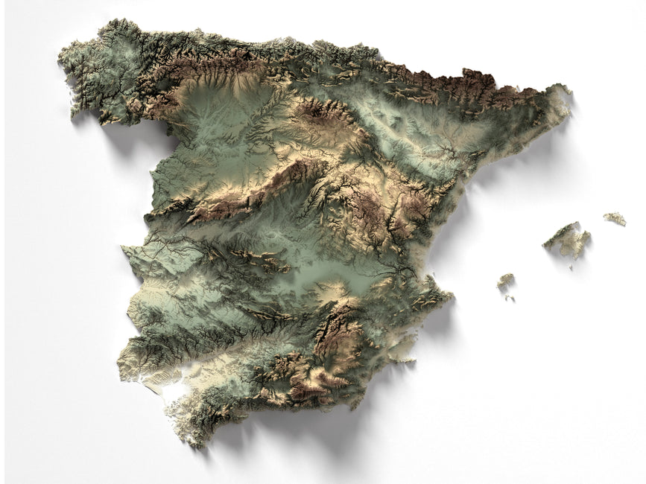
Maps for Reference vs. Art vs. Science

Slide 4
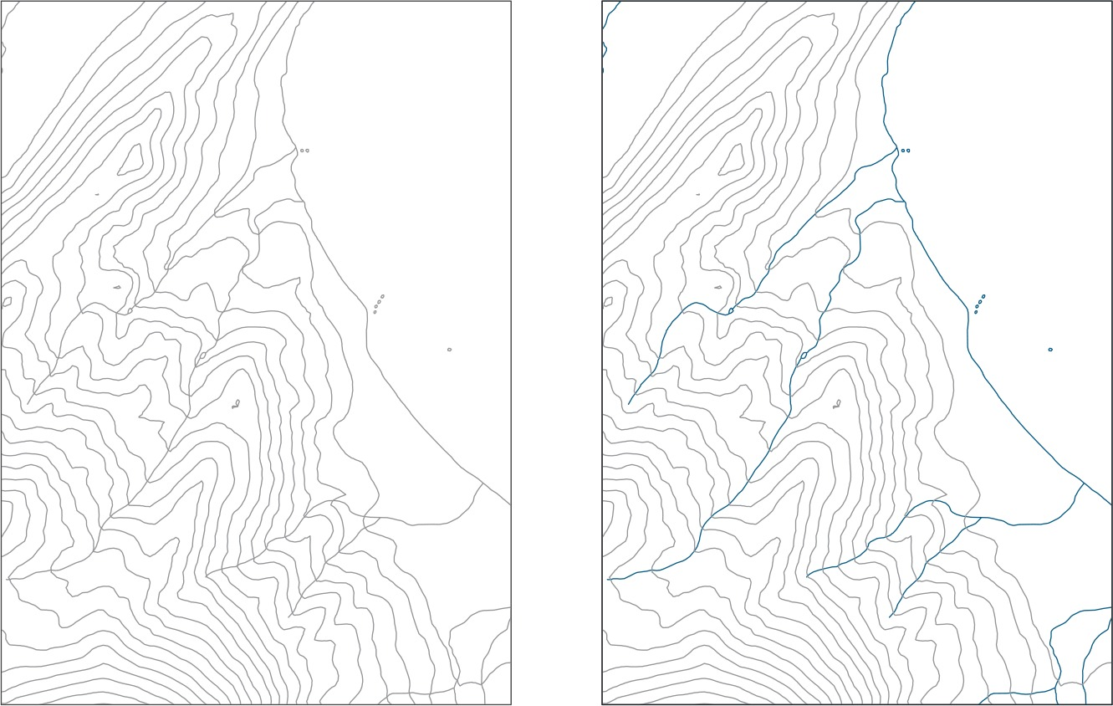
Visual Hierarchy
Bad
Good

Slide 5
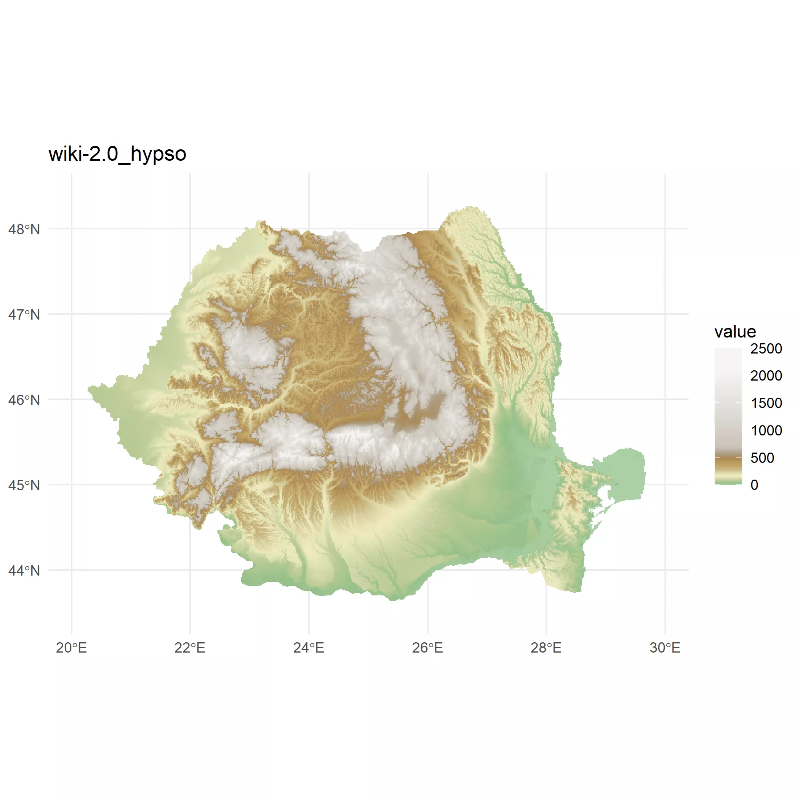
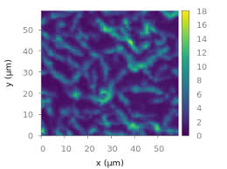
Appropriate Color Scaling

Slide 6
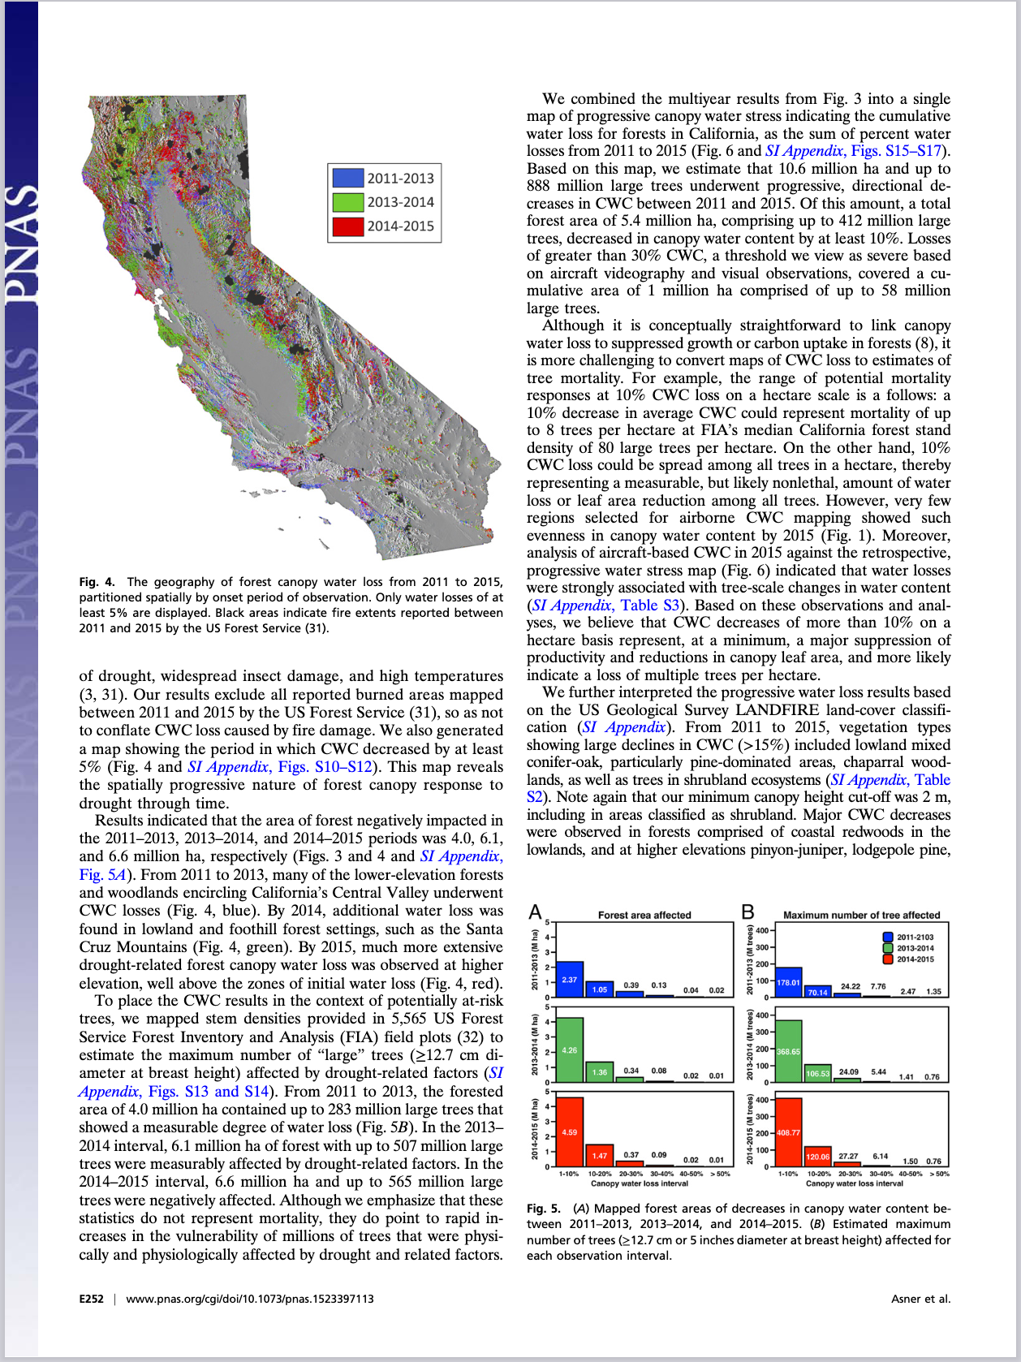
Small, Sparse Design

Slide 7
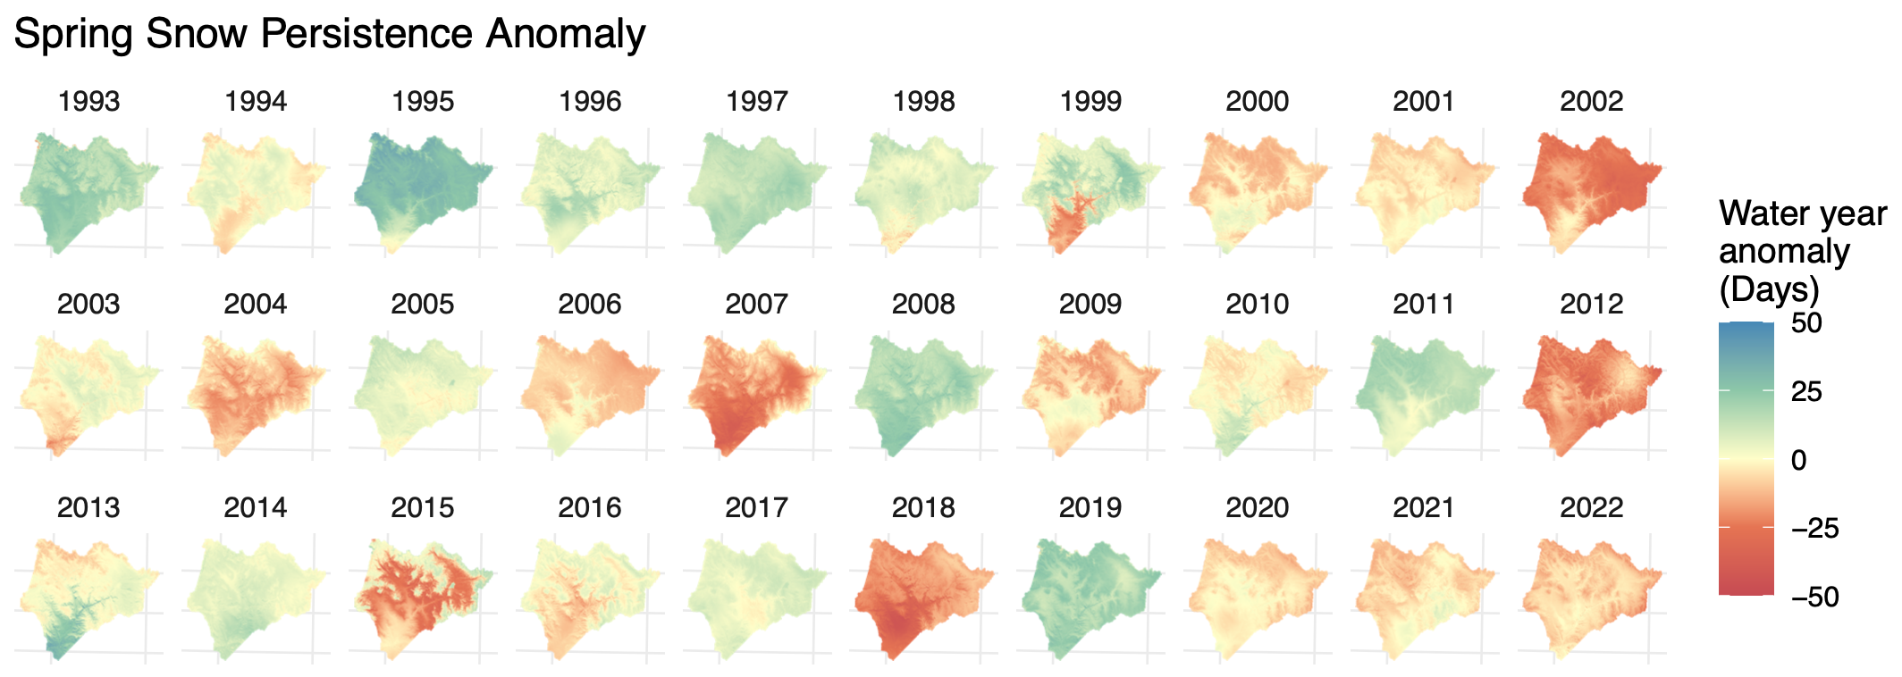
Small Multiples

Slide 8
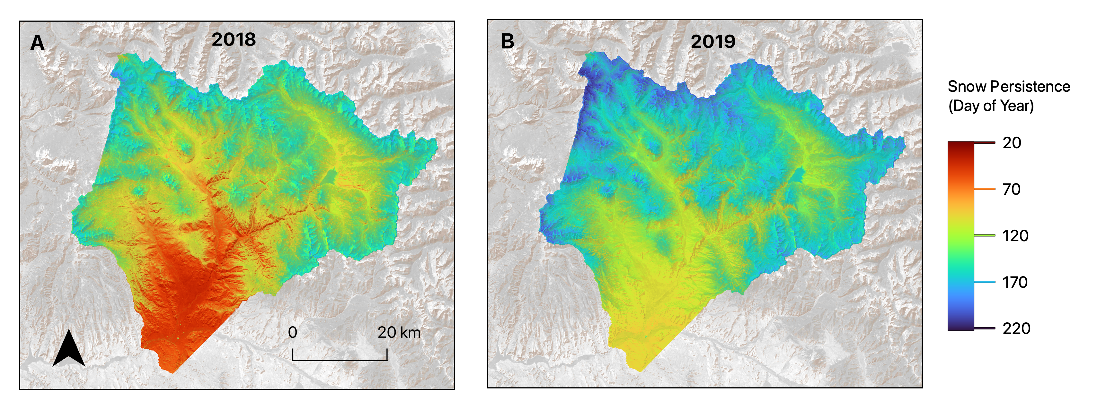
QGIS Demo

Slide 9
The Geospatial Ecosystem of R
R package (s)
Task | terra/raster | stars | sf | lidR | ggplot w/ tidyterra | tmap
Raster Data Processing / Analysis | * | .
Raster Data Visualization | . |  |  |  | * | .
Vector Data Processing / Analysis | . | . | *
Vector Data Visualization | . | . | . |  | * | *
Point Cloud Data Processing / Analysis |  |  |  | *
Point Cloud Data Visualization |  |  |  | *
Others: landscapemetrics, rayshader
.Some Functionality *Lots of Functionality

Slide 10
The ‘raster’ to ‘terra’ transition.
Raster package: first release circa 2008
Terra package: total rewrite circa 2017
Slow transition – both packages maintained.
Recommendation: use ‘terra’ for almost everything except:
Parallel processing using foreach or future.

Slide 11
Projection Problems
Before 2018: proj4 strings
"+proj=longlat +ellips=WGS84"
After 2018: EPSG Codes
”EPSG:4326"
Find the Codes:
QGIS
https://spatialreference.org/

Slide 12
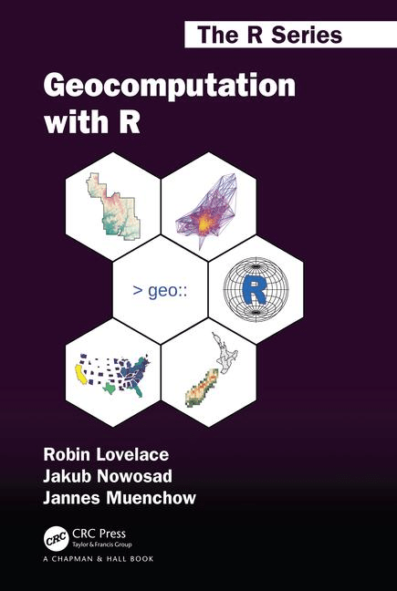
A Great Resource
Geocomputation with R
Free web version:
https://r.geocompx.org/

